Slide 1

Cyber Simulation
Ransomware Attack

Slide 2

Cyber Resilient Care - Why This Matters
Cyber resilience is crucial because it's no longer a question of if an attack will happen, but when - and when it does, your ability to withstand, respond, and recover under pressure could define your organisation’s very survival. This is why, in this ransomware scenario – It is already too late.
Ransomware threats in the UK – Attacks are growing in sophistication, increasingly disrupting essential services.
Severe risks to user safety and data – Double extortion tactics expose personal records, while system downtime can put lives at risk.
The need for resilience and rapid response – Proactive strategies are essential to protect care providers and the vulnerable individuals they support.

Slide 3

Situation
One morning, a few staff in your organisation report their computers and tablets are locked with a single image - a ransom note demanding payment in Bitcoin.
Digital care records, scheduling, payroll, and even some emails are slowly becoming inaccessible.
You need to decide how to respond.

Slide 4
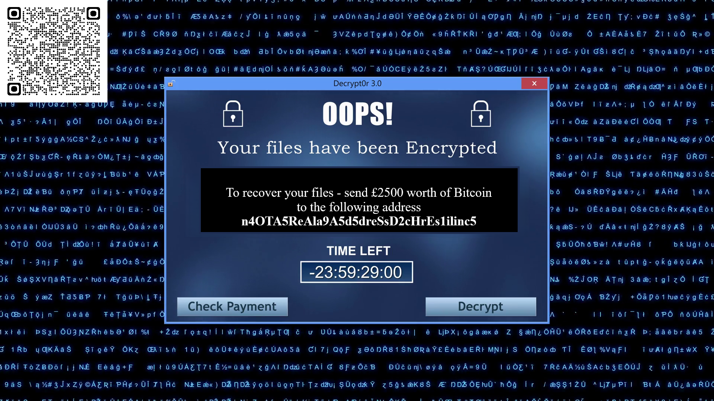


Slide 5


Round 1 – Immediate Actions
Scenario Reminder
Ransomware has started to lock vital care records and scheduling software. A countdown demands payment in Bitcoin. What do you do first?
Option | Action | Background
A | Call the emergency cyber helpline from your insurance | Your insurance policy has a dedicated cyber incident response service. They plan to negotiate and pay the ransom which is covered for the first demand.
B | Ignore it – it may be a hoax | A colleague recalls a past “virus scare” that turned out fake. You decide to carry on as normal, hoping this is just a bluff. Meanwhile, staff temporarily switch to paper records until systems (hopefully) come back online.
C | DIY fixes – use free online tools | Your daughter, who studies computing, points you to free decryption tools online. You attempt to recover files yourself before calling external support.
D | Call your IT supplier & isolate affected systems | You contact your IT supplier or a local specialist cyber company. They recommend disconnecting affected machines to contain the threat. Staff revert to manual processes while experts investigate thoroughly.
Notes:
Insurance vs. Security: Handing over control might ease immediate pressure but can compromise long-term resilience if root causes (backups, staff training, system hardening) remain unaddressed.
Reporting Obligations: Paying doesn’t negate the potential need to notify regulators (ICO, CQC, etc.) if personal data is exposed.
Preparedness: Robust offline backups and a sound business continuity plan reduce reliance on decision making under immense pressure.

Slide 6



Round 1 - Option A |
“Call the emergency cyber helpline from your insurance”
Professional Negotiators: Insurers often use professional negotiators who may secure a lower ransom or better decryption terms. Reduced Immediate Stress: Outsourcing the crisis lets you focus on care. | Summary Your insurance policy allows the insurer’s dedicated cyber incident response team to handle ransomware events. They seek your permission first, but once granted, they take charge - including decisions on negotiation and ransom payment. You’re effectively sidelined as they pursue what they deem the best course of action. | Loss of Control: Usually insurers prioritise minimising risk based on broad data, not care-specific insight - so your long-term security may not be considered. Double Extortion: Attackers may have exfiltrated data, leading to further demands. Moral & Regulatory Concerns: Paying is widely prohibited under UK guidance, as it directly funds criminal activity.
The insurer’s team pays the ransom, and you recover most of your data. Days later, the cyber-gang return, claiming, with some proof, they stole sensitive personal data. They demand more money to keep it private - your insurer refuses further coverage. Additionally, the cyber-gang use the funds to upgrade their ransomware, later striking a major hospital. As in the 2020 German hospital attack, patients are turned away, and lives are put at risk - all because the cyber-gang strengthened their ransomware using the money you paid.
Notes:
Should We Pay The Ransom - The Most Common Ransomware Question
Ransomware negotiators often have pre-existing relationships with various criminal gangs/nation states so know the “language” and techniques for as optimum as possible outcomes – if paying.
Police launch homicide inquiry after German hospital hack - BBC News
Weighing Costs: Sometimes paying appears cheaper than extended downtime or lost care hours, but hidden costs (reputation, morale, and possible repeat extortion) often outweigh that short-term “savings.”
Backups & Preparedness: Having robust, (well tested) offline backups drastically reduces the pressure to pay. If you can restore from backups, you’re less beholden to criminal demands.
Regulatory Issues: In the UK social care context, paying doesn’t absolve data breach reporting obligations (ICO, CQC, or relevant authorities may still need notification).

Slide 7
Round 1 - Option B |
“Ignore it – it may be a hoax”
Avoids Immediate Panic & Overreaction: Staff continue working (albeit on paper) without a major incident response, preventing fear and confusion from spreading unnecessarily. No Immediate Financial Commitment: Delays costly decisions like hiring external cybersecurity experts, paying the ransom, or paying for emergency system restoration. | Summary You downplay the ransom note and temporarily rely on paper backups, seeing it as a short-term fix until digital systems recover through an automated update or patch. But this doesn’t address the underlying infection, allowing the ransomware to keep encrypting data behind the scenes. | Continued Encryption: If real, the ransomware spreads every time a connected device is used. Late Realisation: By the time you confirm it’s genuine, backups might also be infected. Data Theft: Attackers could exfiltrate records undetected while you do nothing.
You dismiss the ransom note as a bluff. Over the next 24 hours, all vital systems seize up. Staff can’t access medication schedules or care user records, risking serious lapses in care. The cyber-gang then publish samples of stolen data online, proving it’s no hoax. Your team scrambles under crisis conditions, losing valuable recovery time.
Notes:
Don’t be an ostrich.

Slide 8
Round 1 - Option C |
“DIY fixes – use free online tools.”
Potential Cost Savings: Some older ransomware variants do have free decrypters. Immediate Action: Staff see you trying to fix the problem promptly. | Summary After hearing about free decryption tools from your daughter, you try to fix it yourself. This might work for older ransomware, but without expert oversight, you risk corrupting data - and the attackers might be watching. If they detect interference, they could retaliate by stealing more data, raising demands, or launching a second attack. | Incompatible Strains: If it’s a new or custom ransomware, free tools might fail or corrupt files. Wasted Time: The longer you experiment, the more time criminals have to exfiltrate or delete data. No Expert Oversight: You may miss deeper breaches or exfiltration attempts.
You spend hours testing decrypters and manual recovery steps using a personal laptop and USB stick. Some files unlock, but others remain scrambled. Meanwhile, the clock on the ransom demand keeps ticking. The cyber-gang notices your attempts and sends you a message. “The demand is now £5000, and we’ll begin leaking personal staff payroll data daily until you stop meddling and pay.”
Notes:
I love to tinker too – but there’s a right time and place. During a crisis isn’t it.

Slide 9
Round 1 - Option D |
“Call your IT supplier & isolate affected systems.”
Limits Spread: Quarantining infected devices prevents further encryption. Professional Approach: Experts handle containment, forensics, and possible data recovery. Confidence: Staff feel reassured seeing a decisive plan. | Summary Realising you’re a little out of your depth, you contact your IT supplier or, if you don’t have one, a local cyber specialist company. You know it’ll cost, but time is critical. Following their clear instructions, you immediately disconnect compromised devices from the network while they get to work. | Short-Term Disruption: Infected systems go offline, potentially delaying routine tasks. Cost: Emergency IT rates or incident response might be pricey. No Instant Decryption: If backups aren’t quick to restore, you still face downtime.
The specialists quarantine the network to protect backups. They find evidence the cyber-gang attempted to steal sensitive data but only managed partial files before being stopped. While some offline fallback processes are needed, you avoid paying the ransom, rebuild from backups, and stop the attackers' leverage.
Notes:
BCP – have a list of 1, 2 or even 3 organisations that you either already have a relationship with (doesn’t have to be a financial relationship) – or at least have their contact details to hand should it be needed.
Most cyber specialist companies (CRC will have a regional professional partner list) will talk to you about the what-ifs – what they can offer should the worst happen. They may even offer free advice – partly because they’ll hope it’ll lead to a future business relationship – but also because as cyber geeks – we love to share our sometimes-niche knowledge!

Slide 10
Round 2 – Communication
How Do You Communicate About the Incident?
It’s Day 1. Staff see their screens locked; families wonder why calls aren’t being returned. Pick one option.
Option | Action | Background
A | ChatGPT drafted memo | Under pressure to release an immediate statement, you need something quickly and lack capacity to draft a clear, detailed memo. Appreciate a knowledge gap and using ChatGPT will provide the right technical terms for credibility.
B | No official statement required | You’re worried about causing panic and decide it’s better to wait for more certainty before saying anything. You trust your staff to quickly adapt until the problem resolves.
C | Process failure | You suspect someone ignored protocols or clicked a malicious link. You issue a comms labelling it a “process failure.”
D | Cautiously Transparent | You explain the ransomware’s impact to stakeholders but hold back technical or sensitive details until investigations conclude. A cyber specialist confirms personal data was stolen, so the 72-hour ICO requirement is a must. However, you don’t have all the required information. You’ll send what you have and hope it’s enough.

Slide 11
Round 2 - Option A |
“ChatGPT drafted memo.”
You deliver something quickly without spending hours writing it yourself. It might impress the handful of IT-savvy staff who understand the terms. | Summary Under pressure to release an official update, you ask ChatGPT to draft your communications. However, you forget to specify that your audience is largely non-technical, so ChatGPT produces a tech-heavy explanation. | Non-technical staff and families are left confused, unsure of what has happened. The overall message sounds alarming but doesn’t offer simple next steps or reassurance. Staff gossip and rumours spread, since few people genuinely understand the memo’s content.
You send the memo verbatim as it sounds right and looks comprehensive. Although you’ve “communicated,” most people remain in the dark about the ransomware. Concerned staff suspect a massive breach because of the intense jargon. Families receive no clarity on whether personal data is safe, prompting anxious calls and further speculation.

Slide 12
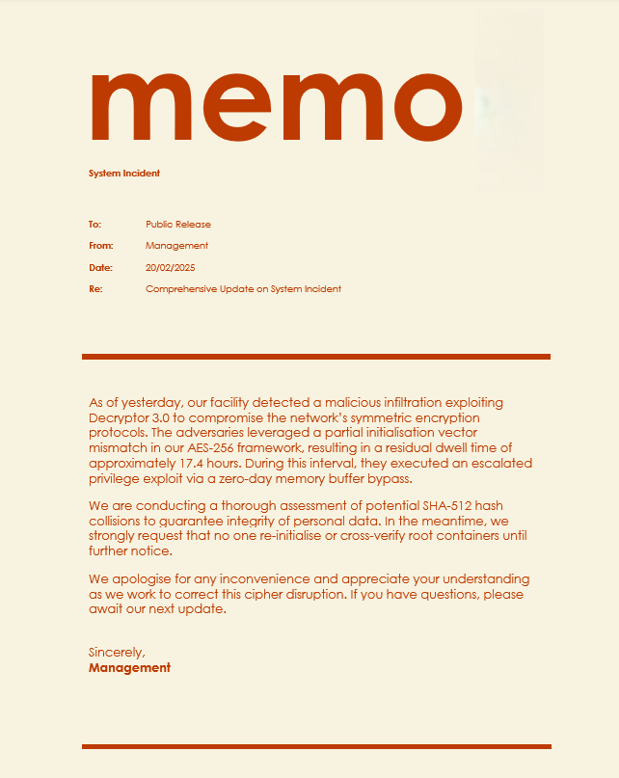

Round 2 - Option A

Slide 13
Round 2 - Option B |
“No official statement required.”
No Immediate Alarm: Staff and families aren’t scared by a formal breach announcement. Minimal Distraction: You can focus on tackling the ransomware without fielding difficult questions. | Summary While delaying an official statement until everything is in order may save time and avoid difficult conversations in the short term, putting off the inevitable often leads to greater fallout, deeper scrutiny, and lasting damage. | Stakeholders and possibly media outlets guess something’s wrong, leading to misinformation. If personal data is compromised, failure to notify the ICO in a timely manner may lead to financial consequences with fines. People feel management is concealing the truth, undermining credibility once the incident inevitably surfaces.
Days pass with no official word, fuelling confusion and speculation. Families overhear staff mention 'the system meltdown,' while stress rises as admin-heavy paper backups slow care. When the ICO learns of the breach, your organisation faces intense scrutiny for delayed disclosure.
Notes:
Ostrich bad.

Slide 14
Round 2 - Option C |
“Process failure.”
Immediate Explanation: By declaring a “process failure,” management appears to have identified the root cause. Emphasises Responsibility: Staff realise there are rules for a reason and breaking them has real consequences. | Summary You suspect someone ignored protocols or clicked a malicious link. Rather than examining broader security measures, you issue a scolding memo labelling it a “process failure.” The subtext implies staff negligence is the root cause. | Fear & Secrecy: Staff may become reluctant to admit other mistakes or near-misses, fearing blame. No Real Solutions: Focusing on a vague “process failure” doesn’t strengthen procedures or training. Damaged Morale: People feel singled out or untrusted, potentially leading to turnover or simmering resentment.
The “process failure” memo circulates, implicitly assigning blame to frontline staff. One team member, feeling targeted, resigns. Others worry about reporting suspicious emails or policy lapses. The underlying vulnerabilities remain, and the ransomware threat is only partially addressed - no tangible improvements in training or technical safeguards follow.

Slide 15
Round 2 - Option D |
“Cautiously Transparent.”
Regulatory Compliance: By notifying the ICO promptly (even partially), you remain compliant. Honest Communication: Staff, families, and regulators see that you’re prioritising transparency and data welfare. Maintained Trust: Openness can calm speculation, demonstrating genuine concern for potential data misuse. | Summary By notifying the ICO within 72 hours, even with partial details, you remain compliant while demonstrating accountability to other stakeholders. Though initial uncertainty may cause concern, proactive communication prevents speculation from spiralling and keeps you in control of the narrative. Providing updates as more facts emerge balances caution with responsibility, ultimately preserving credibility and trust. | Complex Investigation: Gathering enough evidence under tight deadlines is stressful, especially while restoring systems. Ongoing Updates: You’ll need to provide more information as soon as it’s available. This will be time consuming.
You promptly inform the ICO that personal data was taken. Though you lack full clarity, the partial disclosure meets initial obligations. You reassure staff and families, promising further updates once you have more facts. Over the next week, as your investigation unfolds, you submit follow-up details - fulfilling UK GDPR requirements while retaining internal and external trust.
Notes:
From ICO - What if we don’t have all the required information available yet?
"The UK GDPR recognises that it will not always be possible to investigate a breach fully within 72 hours to understand exactly what has happened and what needs to be done to mitigate it. So its Article 33(4) allows you to provide the required information in phases, as long as this is done without undue further delay.
However, we expect controllers to prioritise the investigation, give it adequate resources, and expedite it urgently. You must still notify us of the breach when you become aware of it, and submit further information as soon as possible. If you know you won’t be able to provide full details within 72 hours, it is a good idea to explain the delay to us and tell us when you expect to submit more information."
Personal data breaches – a guide

Slide 16
Round 3 – Lessons Learned
What Long-Term Steps Will You Take?
The crisis is mostly over. Data is restored - or lost. Time for the bigger picture: building resilience for the future…
Option | Action | Background
A | Declare the incident a one-off fluke and move on. | You’re short on time/resources and see no immediate crisis. Staff are relieved the ransomware is fixed, so no deeper investigation is necessary.
B | Identify whoever first triggered the malware and fire them. | All staff have signed their cyber training – so you believe personal accountability is key. Staff must learn from harsh consequences. Quick public resolution to show management acted decisively.
C | Purchase advanced heuristic anti-malware, firewalls, and AI-based link scanning threat detection. | You have budget approval for technological upgrades (Can you tell this is fictional?) Modern solutions will handle future attacks automatically.
D | Conduct a structured debrief, gather lessons, and refine your BCP and procedures. | You recognise the incident exposed gaps in policies, training, or backups. You want a learning culture, not a blame culture, to ensure better resilience next time.

Slide 17
Round 3 - Option A |
“Declare the incident a one-off fluke and move on.”
No Extra Work: No debrief sessions, no new policies, no additional training. Staff Relief: People are glad not to rehash a stressful incident. | Summary You hope ignoring it will keep daily operations calm and avoid extra administrative burden. But you’re effectively burying the problem, leaving your organisation exposed. | Same Vulnerabilities: Nothing changes, so future breaches are likely. No Institutional Memory: Hard lessons aren’t captured, so mistakes repeat.
Three months later, a new ransomware variant hits. The realisation that no one learned anything hits hard. No updated processes, no improved backups. The cycle repeats, the systems are down. Again.

Slide 18
Round 3 - Option B |
“Identify whoever first triggered the malware and fire them.”
Immediate Explanation: Stakeholders appreciate you’ve found the root cause. Strong Deterrent: Some staff will think twice before ignoring security protocols. | Summary You hope making an example out of someone will scare others into compliance. But ultimately, you undermine honesty and hamper early incident reporting. | Culture of Fear: Staff hide errors and near-misses to avoid blame. No Real Solutions: Punishment alone doesn’t improve training or fix system gaps.
Some time later a senior staff member accidentally forgets to report a suspicious email, their anxiety is so overwhelming that they quit on the spot. Slowly at first, more experienced staff follow. Eventually, your strict stance on mistakes leaves you struggling to stay afloat as you grapple with high turnover and an inexperienced workforce.

Slide 19
Round 3 - Option C |
Purchase advanced heuristic anti-malware, firewalls, and AI-based link scanning threat detection.
Reduced Routine Threats: Many phishing or malware attempts might be filtered out. Shows Commitment: Stakeholders see your organisation learns quickly and plans decidedly. | Summary You’re trying to arm your organisation with top-notch defences. However, without improved processes or staff awareness, confidence tricksters can still succeed. | Human Weaknesses Remain: Social engineering (phone calls, impersonation, phishing) can bypass even the best tech. False Sense of Security: Throwing money at an issue without any investment of time, rarely yields a good ROI.
A scammer phones reception claiming to be “Microsoft Tech Support,” convincing the people-pleasing staff member to helpfully install TeamViewer to update their system. The new hardware is useless against human nature - attackers can bypass it entirely.

Slide 20
Round 3 - Option D |
Conduct a structured debrief, gather lessons, and refine your BCP and procedures.
Holistic Improvement: Strengthens technology, processes, and people. Openness & Trust: Encourages staff to report concerns early, enhancing threat detection. Peace of Mind: A stronger BCP means fewer attack vectors and greater resilience. | Summary You aim to learn from the ransomware attack, bridging policy gaps and boosting staff readiness. This fosters a proactive environment that can withstand future threats. | Takes Time & Effort: Scheduling debriefs, rewriting BCP, delivering training all require resources. Initial Discomfort: Testing BCPs can break the flow of daily operational workings.
A few months later, a staff member receives an email in their personal inbox, claiming their very private photos will be leaked unless they pay. Recognising the tactic from recent training, they immediately report it to Action Fraud. The police swiftly isolate the threat and locate the culprit, preventing others from falling victim to the same anxiety-inducing scam. Your commitment to continuous learning and an open culture has strengthened both staff resilience and your organisation’s security.

Slide 21

Summary
Balance Tech & Culture
Fancy software won’t help if staff are afraid to speak up or poorly trained.
Learn & Improve
Even a bad incident can lead to better policies and a stronger team if you do a proper review.
In a perfect world, we’d never face ransomware. But in a perfect world, I’d have unlimited zero-calory biscuits.
Since reality doesn’t quite match up, be prepared.
Preparation Over Panic
A tested BCP or incident response plan helps you avoid chaotic guesses during a crisis.
Honest Communication
Silence or jargon can foster mistrust; clarity fosters unity.

