Slide 1
Cybersecurity Event for Adult Social Care Providers
Tuesday 3rd June

Slide 2
Session 2:
Inside the mind of a hacker – lessons from the other side

Slide 3
Inside the Mind of a Hacker
Sam Cattell
Technical Cyber Lead – Digital Care Hub

Slide 4






What are we going to discuss?
Introductions
Hacking 101
Hackers Mindset
Defence
Who am I?
What is hacking?
What do hackers want?
What an attack journey looks like
Step-by-step hacking example
Test your current email and password
DSPT – Hacker’s Nightmare
Round-up and Reporting
Notes:
So, what are we covering in your session today?

Slide 5



Who am I?
I’m Cyber Sam! Ex Head Chef and…
10+ yrs | Ethical Hacker, Pen Tester and Cybersecurity Consultant
4 yrs | Advanced Fraud and Cyber Crime Investigator for HSBC UK
3 yrs | Regional Cyber Coordinator for NHS England & Lead for Cyber Intelligence
Trusted advisor & ethical hacker for NHS, local authorities, regional organised crime units & Cyber Resilience Centres
Present - Technical Cyber Lead, Digital Care Hub

Slide 6

“A hacker is an unauthorised user who attempts to gain access to an information system.”
Black Hat
  Ignore the law
  No/broken moral compass
Grey Hat
  Bend the law
  Moral compass / personal code
White Hat
  Follow the law
  Strong moral compass / code of conduct
  Boring
Notes:
Examples:
Black Hat: The BlackCat ransomware group, also known as ALPHV or Noberus, is a notorious example of a Black Hat hacker group. They operate on a ransomware-as-a-service (RaaS) model, targeting organisations worldwide and demanding ransom.
Grey Hat: Grey Hat hackers often operate in a middle ground between ethical and malicious hacking. They might hack systems without permission but without malicious intent. For example, Marcus Hutchins, who stopped the WannaCry cyberattack, was later arrested for creating malware.
White Hat: Cyber Sam! 😁

Slide 7
Hacker’s Motivation
Greed Revenge Curiosity Technical challenge | Hacktivism Espionage Cyber terrorism State sponsored

Slide 8
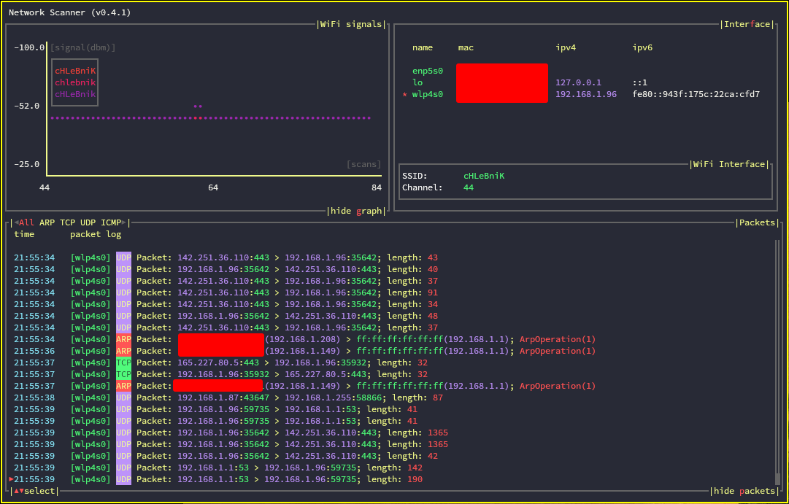
Hacking at Scale
Hacking for profit by organised criminal gangs often employ a scatter gun approach.
Initial focus is on finding vulnerabilities
These are not targeted to a specific organisation but rather numerous potential victims.
Once weaknesses are identified, hackers can then begin conducting targeted attacks.

Slide 9
🧑‍💻Vulnerability Example…
Type in your current website on your devices address bar, for me >
www.digitalcarehub.co.uk
Before you hit “enter” or “go” end the .co.uk/.com etc with >
/wp-admin
So in the address bar would be >
www.digitalcarehub.co.uk/wp-admin

Slide 10

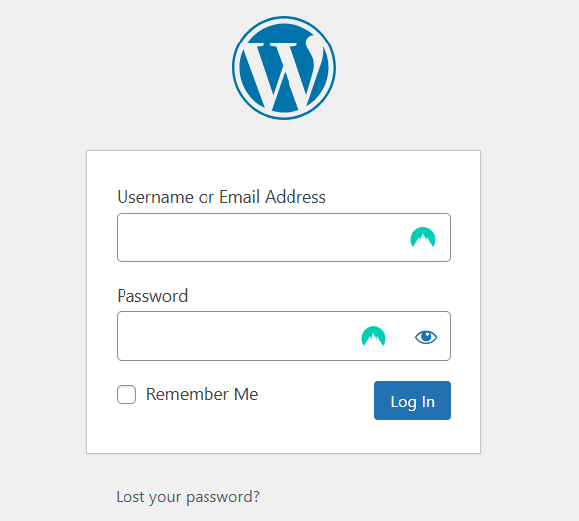

Slide 11



Now you know that website is built using WordPress
Now you know the website designers haven’t disabled the admin dashboard

Slide 12

Hacker Thinking
OSINT
Phishing
Artificial Intelligence
Social Engineering/Digital Footprint
Lateral Movement
Password Cracking

Slide 13

Open-Source Intelligence Gathering (scouting)
OSINT is the collection and analysis of data gathered from open sources (overt sources and publicly available information) to produce actionable intelligence.
How many of you have you have been involved with this type of intelligence gathering?

Slide 14

Open-Source Intelligence
…You ever checked on your best friend's new date on social media?
Search Engines (Google, DuckDuckGo, Yippy, DogPile)
Companies House
Reverse Image Search (TinEye, Google)
Social Media (Facebook, LinkedIn, IG)
HUMINT (Friends, colleagues, family members)

Slide 15
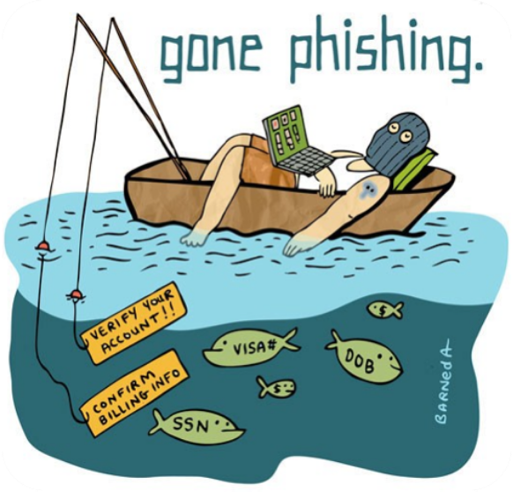
Phishing Attacks
🎣
Phishing Scams
Phishing | Spear Phishing | Whaling
---
Vishing | Smishing | Quishing
---
The scam changes but the 3 things they want you to do never change
---
Click on a link | Open an attachment | Divulge information
---
Motivation: Want your login details, want to deliver malware, want your data
---
Use tried and tested psychological cues to action
Authority. Scarcity. Time Pressure.

Slide 16

AI-Powered Social Engineering: An Ongoing Threat
The rise of AI tools, like ChatGPT, has made social engineering scams more sophisticated and convincing. Attackers can now generate highly persuasive messages in numerous mediums with flawless language, mimicking real businesses or individuals with ease.
Key Risks:
AI automates at scale, increasing attack volume.
Emails & messages are harder to detect, even for trained users.
Traditional anti-phishing defences may struggle to keep up.
As AI evolves, staying ahead of these threats requires stronger detection strategies and awareness efforts.

Slide 17

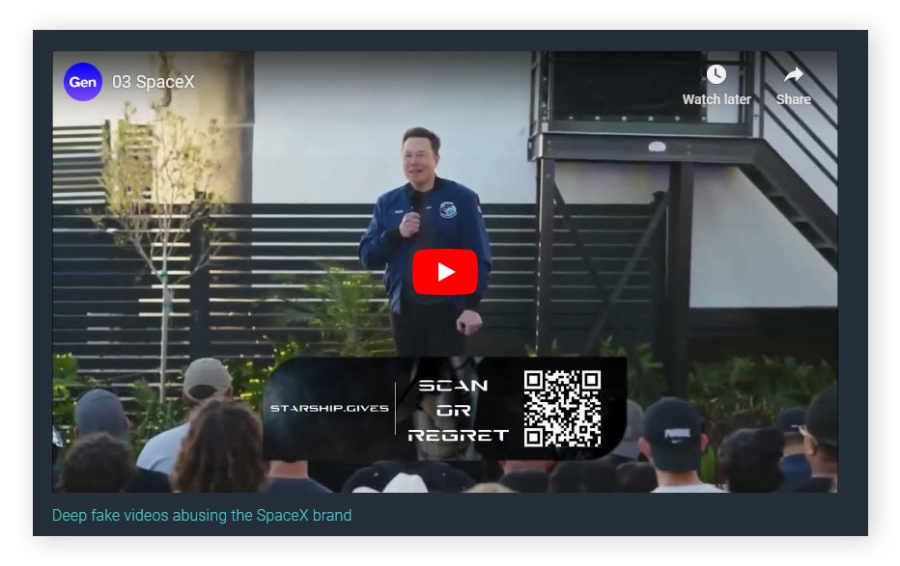
AI-Powered Deepfakes: An Emerging Threat
Deepfakes, which are AI-generated synthetic media (pictures, videos, audio), pose significant risks in the realm of hacking. With the ability to almost perfectly mimic real people – the risk is ever increasing.
A finance employee in Hong Kong was tricked into transferring $25 million using deepfake technology. Scammers created a fake video conference with the company's CFO and other executives, convincing the employee to send the funds. They used past video footage and AI-generated voices and videos to make the deception convincing.
Key Risks:
Trick people into sophisticated scams.
Spread misinformation and manipulate public opinion.
Exploit personal privacy and security.
Conduct blackmail and harassment.

Slide 18

Social Engineering: What’s the big deal if someone knows…
"That I went and had a pizza last night?"
"It's my birthday?"
"What my new car looks like?"
"What the weather is like outside?"

Slide 19

Social Engineering: Using Your Digital Footprints
"That I went and had a pizza last night?"
Find out which restaurant you used, and spear phish with coupons from that place
"It's my birthday?"
Know your DoB or part of it for identity theft or more believable social engineering
"What my new car looks like?"
With the license plate I now know when your MOT/Tax is due for renewal (spear phish)
"What the weather is like outside?“
Triangulate where you live from the image surroundings. Send official looking letters.

Slide 20

Phishing Attacks
Password Cracking
HaveIbeenpwned – Check for breaches then find or buy
Credential stuff using breached accounts
Software for the actual password attack (John the Ripper/Hash Suite etc) in order;
  Use breached passwords and variations first;
  Use most common used passwords next;
  Dictionary attack after this – using all known words, including swapping e for 3, 5 for s etc;
  Brute force final – every character possibility. Very long, sped up with GPUs and multithread chips.

Slide 21
Phishing Attacks
www.ncsc.gov.uk/static-assets/documents/PwnedPasswordsTop100k.txt
123456 | 1234567890 | 123456a | 123abc | zxcvbnm
123456789 | 123123 | 654321 | 1q2w3e4r | 1g2w3e4r
qwerty | 000000 | 123321 | qwe123 | gwerty
password | iloveyou | 666666 | 7777777 | zag12wsx
111111 | 1234 | 1qaz2wsx | qwerty123 | gwerty123
12345678 | 1q2w3e4r5t | myspace1 | target123 | 555555
abc123 | qwertyuiop | 121212 | tinkle | *uckyou
1234567 | 123 | homelesspa | 987654321 | 112233
password1 | monkey | 123qwe | qwerty1 | asdfghjkl
12345 | dragon | a123456 | 222222 | 1q2w3e

Slide 22

Phishing Attacks
Lateral Movement
Ultimate Aim
The goal is to gain access to admin credentials or email accounts. For a lateral movement attack, we just need to keep sniffing around.
First Breach
Imagine the first account I breach is an obscure gaming website you signed up for as a child. I can use those credentials (password variants) on every known site you can think of - eBay, gambling sites, social media, anything. The more accounts I breach, the larger picture I can build of the target, making it easier to breach via either more credential stuffing or social engineering.
Email Access
Once I have access to your email, I can start resetting every other account connected to it. I can also set up an auto-forward rule, so even if you change your password, I'll get a copy of every email you receive.

Slide 23

Ok – but how would I ACTUALLY do it?

Slide 24
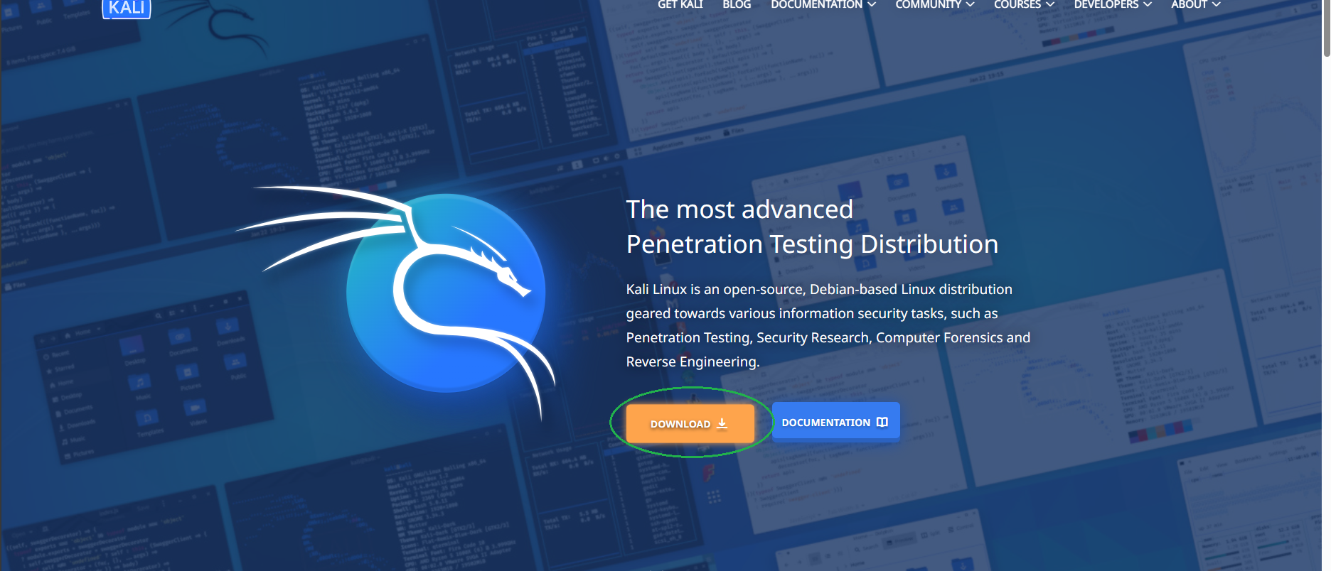
1 - Prepare
Notes:
Prepare

Slide 25
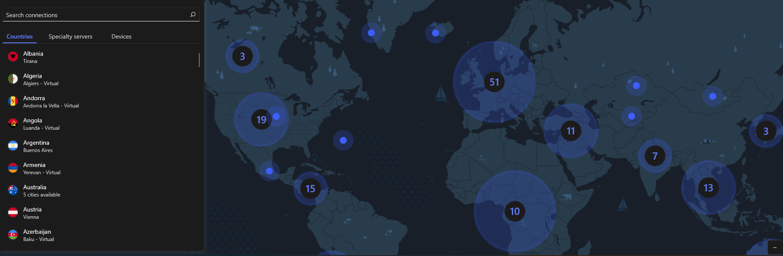
2 - Hide
Notes:
Hide

Slide 26
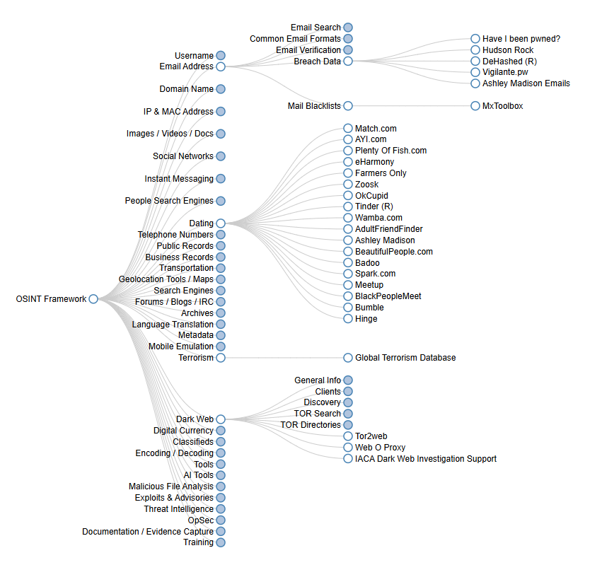
3 - Scout
OSINT Framework
OSINT framework focused on gathering information from free tools or resources. The intention is to help people find free OSINT resources. Some of the sites included might require registration or offer more data for $$$, but you should be able to get at least a portion of the available information for no cost.
I originally created this framework with an information security point of view. Since then, the response from other fields and disciplines has been incredible. I would love to be able to include any other OSINT resources, especially from fields outside of infosec. Please let me know about anything that might be missing!
Please visit the framework at the link below and good hunting!
http://osintframework.com
(T) - Indicates a link to a tool that must be installed and run locally
(D) - Google Dork, for more information: Google Hacking
(R) - Requires registration
(M) - Indicates a URL that contains the search term and the URL itself must be edited manually
Notes:
Scout

Slide 27
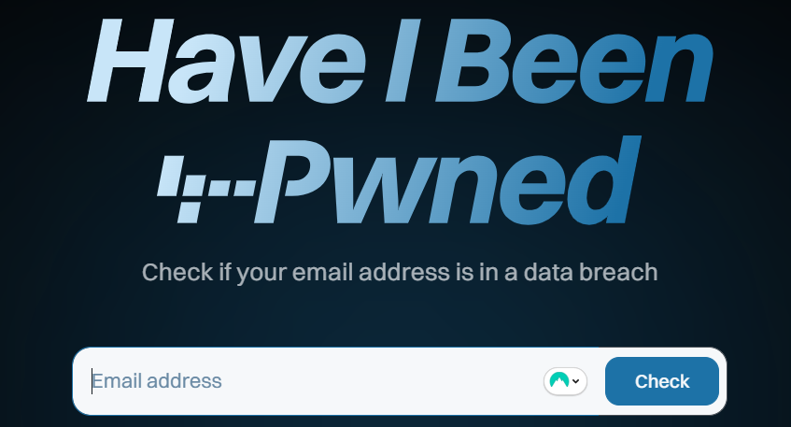
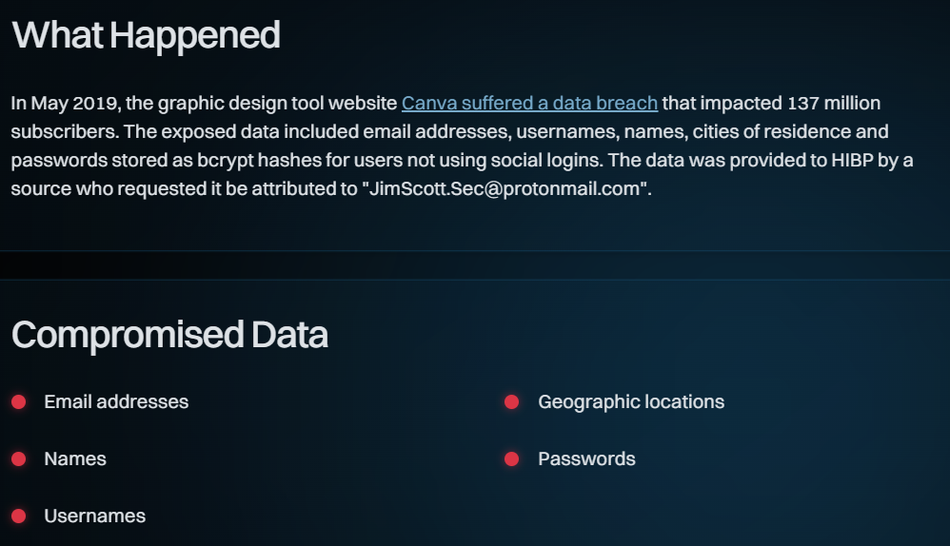
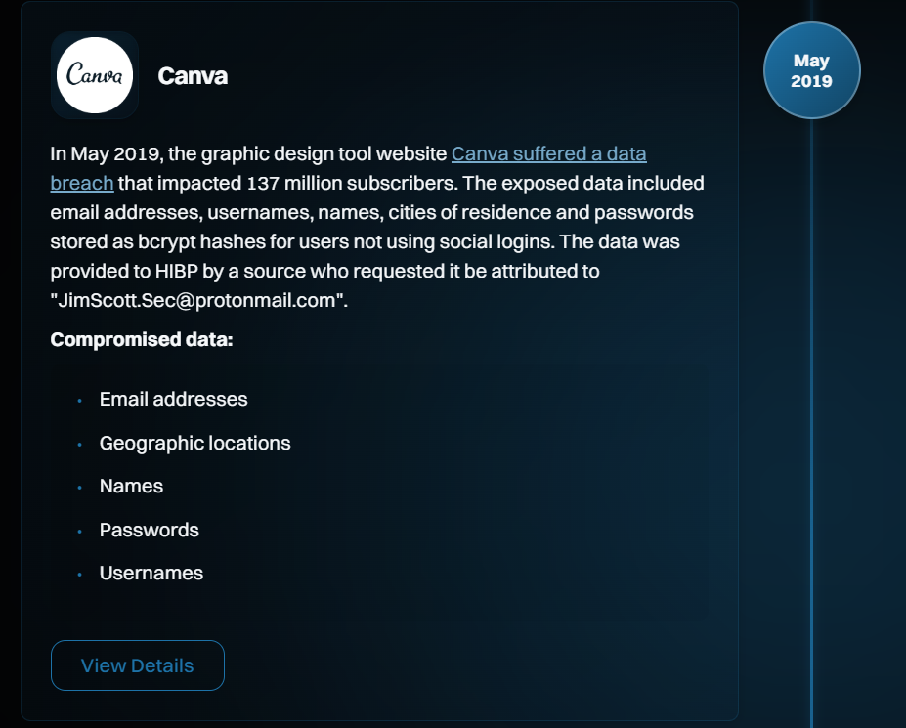
Notes:
Search

Slide 28
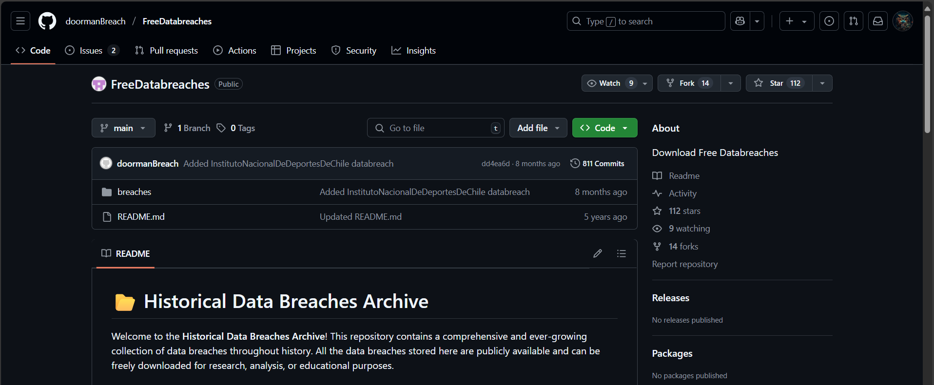

Slide 29
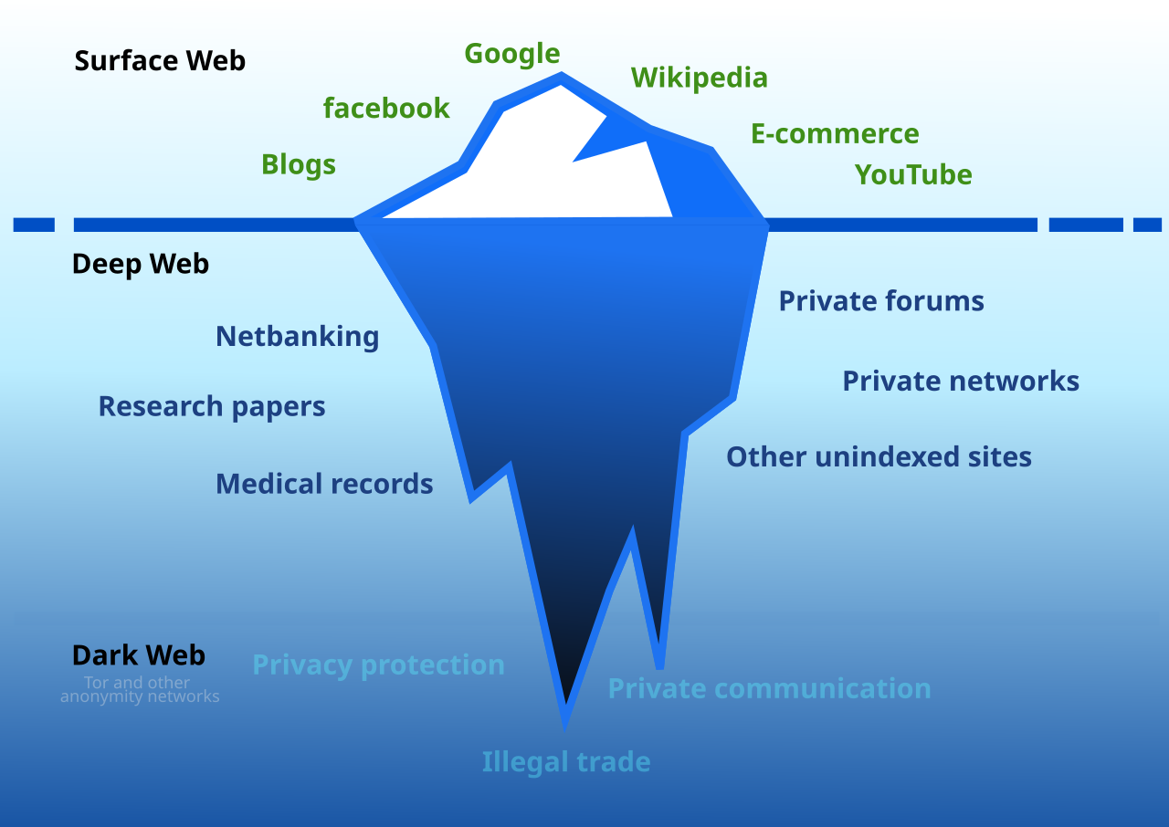
By Original image released by Ranjithsiji under the Creative Commons Attribution-Share Alike 4.0 International license
Notes:
By Original image released by Ranjithsiji under the Creative Commons Attribution-Share Alike 4.0 International license on 17 April 2018.Modified by Flori4nK for a more accurate representation. - Original: https://commons.wikimedia.org/wiki/File:Deepweb_graphical_representation.svg, CC BY-SA 4.0, https://commons.wikimedia.org/w/index.php?curid=89178055

Slide 30

Notes:
Well known forums, hacking sites, criminal leak sites, and marketplaces on the darknet.

Slide 31
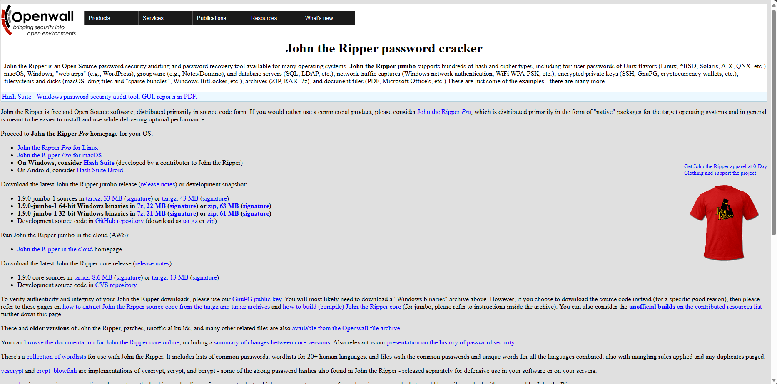
Notes:
T-shirt ☺

Slide 32
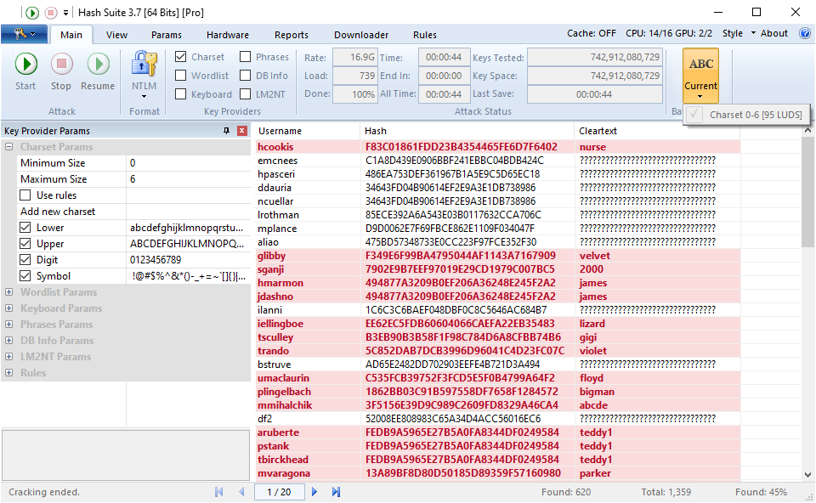

Slide 33
So how would you defend against me?

Slide 34

Test Your Email
Has your email been involved in a breach?
haveibeenpwned.com
Or scan the QR code >
Don't panic if your email is found; monitor for social engineering attempts, change any breached passwords, and update all reused passwords asap.

Slide 35

Test Your Password
Test the Strength of your Password
security.org/how-secure-is-my-password
Or scan the QR code >
Name | Number of Zeros
Thousand | 3
One Hundred Thousand | 5
Million | 6
Billion | 9
Trillion | 12
Quadrillion | 15
Quintillion | 18
Sextillion | 21
Septillion | 24
Octillion | 27
Nonillion | 30
Decillion | 33
Googol | 100

Slide 36
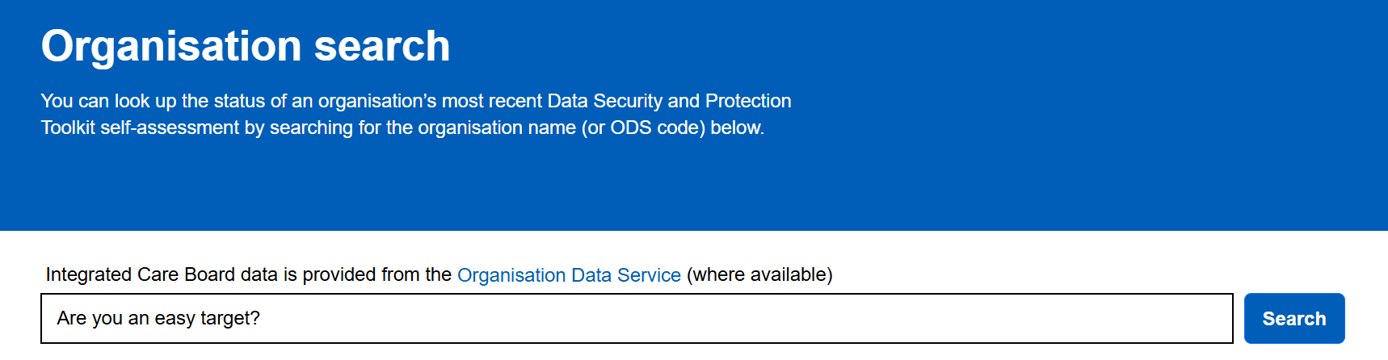
The DSPT
The Data Security and Protection Toolkit is an online self-assessment tool that allows organisations to measure their data protection and cyber resilience against an annual checklist based on some of the most prolific vulnerabilities known.
Do you think a Hacker won’t think to check your organisations publication status? Not published? Out of date? These can all be indicators to a bad actor the weaknesses your organisation may have…

Slide 37
DSPT – Hacker’s Nightmare!
DSPT Evidence Item | Why Nightmare
4.2.4 Does your organisation have a reliable way of removing or amending people’s access to IT systems when they leave or change roles? | It’s much harder for me to use stolen credentials
4.5.4 How does your organisation make sure that staff, directors, trustees and volunteers use good password practice? | It will take me forever to breach a strong password; I’ll give up and try something else
6.2.1 Do all the computers and other devices used across your organisation have antivirus/antimalware software which is kept up to date? | Any off-the-shelf malware will be picked up immediately, I need to rethink my payload
7.3.4 Are backups routinely tested to make sure that data and information can be restored? | Even if I manage to deploy some ransomware – they’ll be back up and running in no time
8.3.5 How does your organisation make sure that the latest software updates are downloaded and installed? | None of their software is showing as vulnerable in my scans, NEXT!
9.5.2 Are all laptops and tablets or removable devices that hold or allow access to personal data, encrypted? | I stole this tablet from an exhausted carer on the bus, and I can’t do anything with it
10.2.1 Do your organisation’s IT system suppliers have cyber security certification? | Their supplier is absolutely on it; I can’t attack the supply chain as they are just as resilient as the organisation. I GIVE UP!

Slide 38

DEFENCE – OVERVIEW
Social Engineering
Review your privacy settings – Limit what personal info is visible on social media.
Pause and think – Does the message create urgency (authority, scarcity, time pressure)? Take a moment before acting.
Verify before you trust – Independently confirm requests for sensitive info, payments, or urgent actions via a separate channel.
Patch and patch again
Keep everything up-to-date
Use antimalware
Use auto updates where available
Good password practise
Different passwords for different logins (especially email)
The longer the better, 3 random words to help better memorise
MFA and use a password manager where possible
Training
keep yourself and any staff refreshed. There is plenty of good free and paid training available out there
Don’t struggle alone
Use a framework to assist you and your organisation such as the DSPT or Cyber Essentials. Check out Digital Care Hub for free templates and advice.

Slide 39

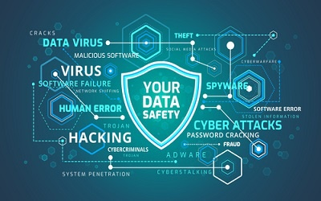
Reporting
Suspicious Email Reporting Service (SERS) at report@phishing.gov.uk
Text messages can be forwarded to 7726
If you think someone is trying to trick you into handing over money or personal details - stop, hang up and call 159 to speak directly to your bank – www.stopscamsuk.org.uk/159
If you have been hacked or lost money due to these types of attacks, report to Action Fraud at www.actionfraud.police.uk or 0300 123 2040

Slide 40
Prepared. Not Paranoid.
Thank you for listening!
Cyber Sam sam@digitalcarehub.co.uk

Slide 41
Session 3:
How the DSPT is your worst Nightmare

Slide 42
Data Security Protection Toolkit
EM 3rd June 2025

Slide 43
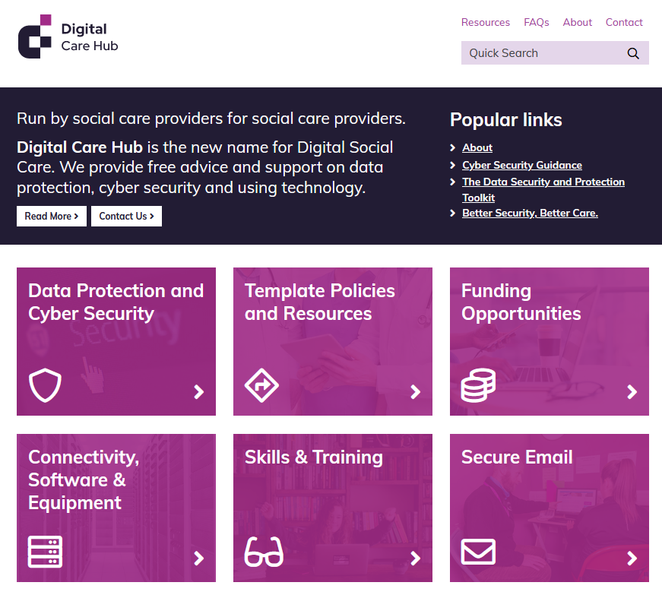
Digital Care Hub – who are we?
  Run by social care providers, for social care providers.
  A sector led community interest company. We represent care providers of adults with physical, sensory or learning disabilities, people with mental ill-health, and older people
  We work in partnership with providers, representative bodies, and statutory bodies to support the digital journey of adult social care providers in England.

Slide 44
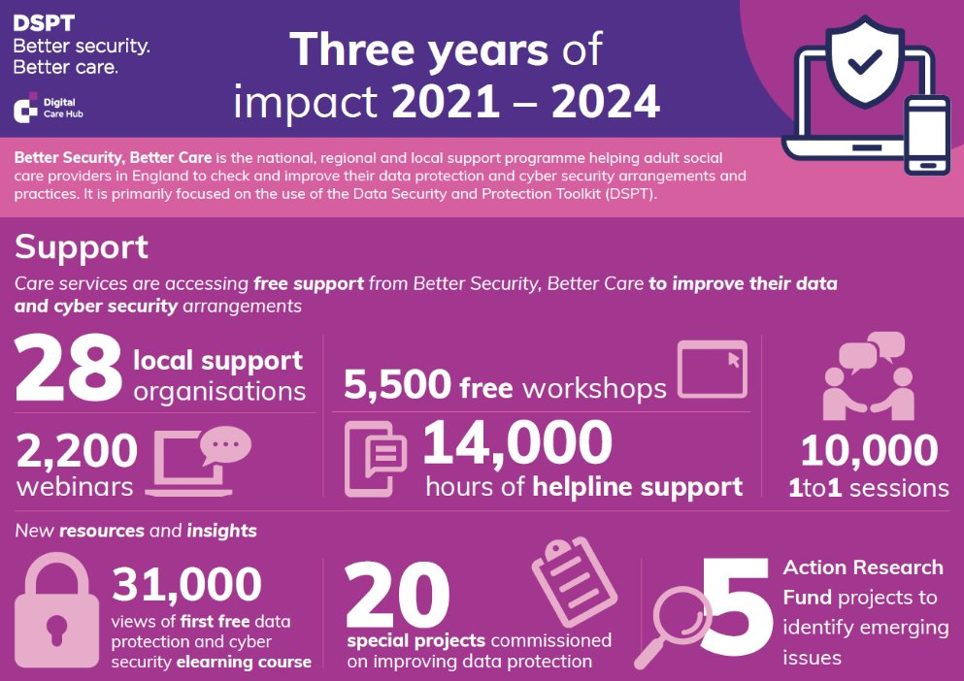

Slide 45
In 2 years…
30% more homecare services are using the DSPT​
80% of nursing homes are using the DSPT​
70% of care homes without nursing are using the DSPT​
58% of learning disability services are using the DSPT​

Slide 46
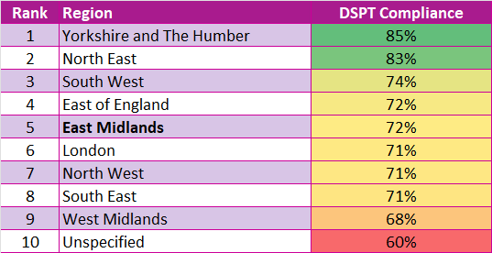

National comparisons
Thank you for your hard work in raising the importance of data and cyber safety amongst your commissioned care providers

Slide 47
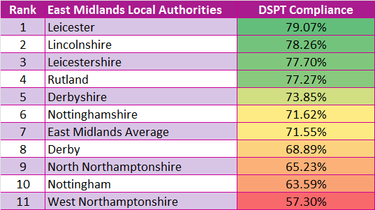
Let's break that down...
If you need support to improve compliance in your area – contact your Local Support Organisation.​
​
They will offer direct, 121 support with providers and take the hard work out of your hands.​
​
Aligns with What Good Looks Like Framework Measure 3: Safe Practice​

Slide 48

Complexity of a modern small organisation
Emails​
Mobile devices​
Websites​
Social media​
Ecommerce systems​
Online banking​
BYOD and office policy​
Network management​
Backup and remote access

Slide 49
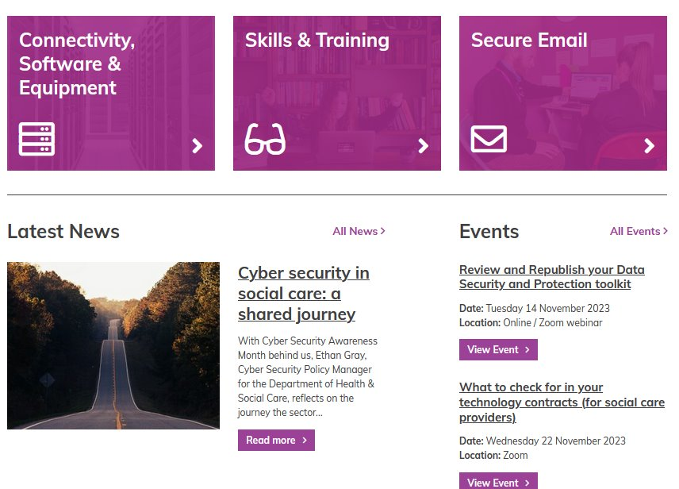
What do we do?
Guidance and support
Helpline
Success Stories
Newsletter
Funding resources
Events and webinars
Digital Special Interest Group
and more …

Slide 50
The Frameworks- how it connects
LA's increasingly have DSPT in contracts with care providers
CQC have included it in the single assessment framework
DHSC have included it in What Good Looks Like Framework
BSBC working closely with ADASS
Skills for Care in their Digital Framework

Slide 51
The Benefits
The time will come when CQC will be requiring data to be available digitally & you will need good data protection procedures in place.
Shared systems e.g. proxy access to GP records & NHSmail​
Increasingly becoming a contractual requirement of providing services to Local Authorities​
Enables compliance with various legal requirements & legislation​
Can be linked to CQC KLOEs – one step towards becoming an outstanding provider​
Opportunity to audit processes, systems and policies​
Reassures staff and clients that you take data protection seriously​
Accredited and understood by the wider system​
​
​

Slide 52
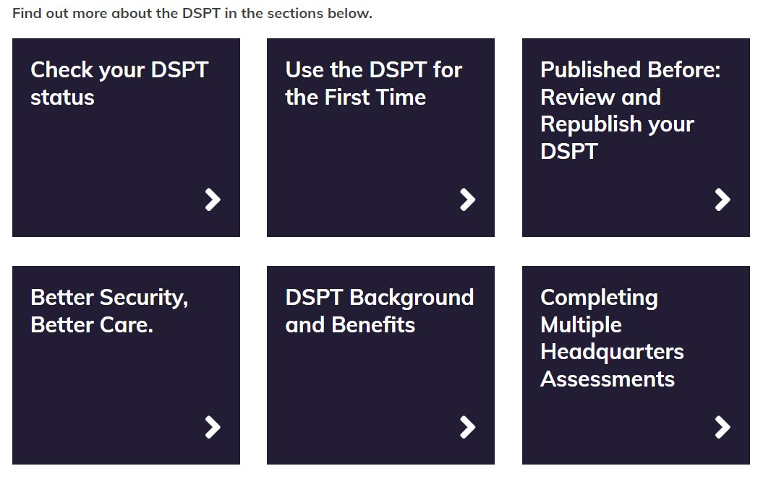
Your fellow travellers
Free and official​
Online guidance, step by step films​
Webinars​
FAQs​
Template policies​
Helpline​
Tailored support from 28 Local Support Partners across England​
digitalcarehub.co.uk/bettersecuritybettercare​

Slide 53
Why bother?
Data and cyber security, arrangements, DSPT and insurance claims
According to the Cyber Claims report 2022, the average cost of a claim for a small business owner was £115,000
Insurance companies are demanding that before an insurance policy is issued or renewed, the enterprise must show they have the tools in place to protect against ransomware.

Slide 54
Key Areas

Slide 55
Smartphones – BYOD or Provide?
Bring your own device​​ | Corporate Owned​​
Pros: ​​ ​More cost effective​​ Staff already comfortable using the device​ | Pros:​​ Easier to ensure they are managed securely​​ Better oversight​​
Cons:​​ Need to enforce BYOD policy​​ Less oversight​​ | Cons:​​ Cost​​ May require technical expertise​​

Slide 56
Have a business continuity plan that includes data and cyber security
A business continuity plan that includes data and cyber security will help you to manage risks such as:​
If you lost data records ​
If you were hacked​
If phone operating systems were down​
If your supplier’s system failed​
Don’t forget to test your plan!​
Download a template business continuity plan from Digital Care Hub​

Slide 57
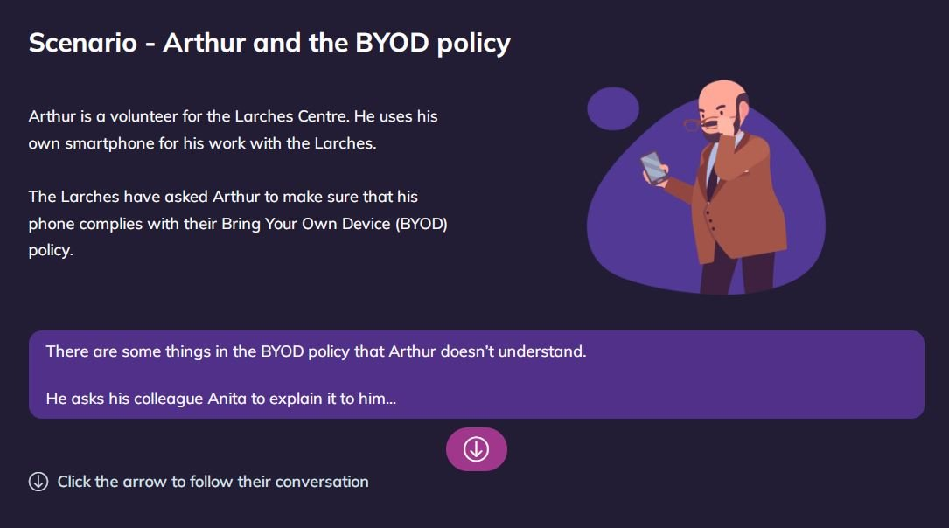
Staff training
Don’t underestimate human error.​
Cyber awareness training will educate staff on important issues such as how to spot a cyber-attack.​
Use Better Security, Better Care’s free elearning resource for frontline care staff on data and cyber security. ​

Slide 58

Manage your supply chain
You’re only as strong as the weakest link in your supply chain.​
Check what security controls your suppliers have in place & consider asking them to seek out Cyber Essentials Plus certification.​
Use Digital Care Hub’s supplier list template to keep track of what suppliers process personal information.​

Slide 59
Your ‘Toolkit Journey’ – start now!
REGISTER
COMPLETE
All 42 questions
PUBLISH Standards Met or Exceeded
REVIEW Every year
Deadline: 30th June
26 Mandatory Questions & Action Plan
PUBLISH Approaching Standards (Once only)

Slide 60
If you’re completed in previous years:
You’re halfway there!
LOG IN
REVIEW & UPDATE existing answers
COMPLETE ALL MANDATORY QUESTIONS
6. PUBLISH
By 30th June
Keep your DSPT up to date. Republish at least once a year

Slide 61

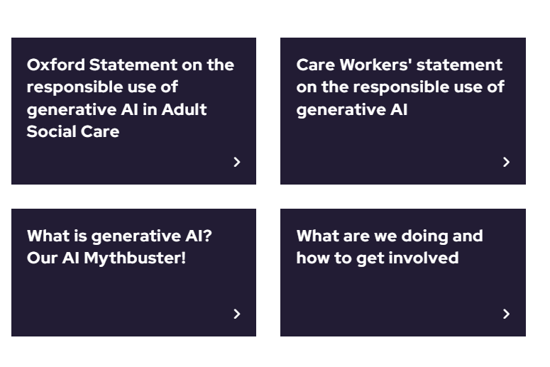
AI
The Oxford Statement on the Responsible use of Generative AI in Social
First of a series of ‘AI in adult social care’ roundtable events to take place as part of a co-production initiative for people in adult social care
Representatives from over 30 organisations took part (ADASS were present)
Oxford Project: The Responsible Use of Generative AI in Care

Slide 62
Get Involved!
Digital Care Hub Newsletter - https://www.digitalcarehub.co.uk/newsletter-signup/
Digital Care Hub Special Interest Group – contact hello@digitalsocialcare.co.uk
NEW – Social Care Caldicott Guardian Network – contact hello@digitalsocialcare.co.uk

Slide 63
Information and Resources
Skills for Care videos
  Change management - sharing lessons and learnings from managers leading digital change in their services
  I’m a technophobe, get me out of here – taking the fear out of digital for social care managers
  How can technology support the delivery of care?
  Supporting digital leadership in adult social care
  Using technology to support your staff and each other
  Using technology to support the people you care for
Digital Care Hub​
  Funding​
  Better Security, Better Care​
  AI & Robotics​
NHS England’s Digitising Social Care​
  Assured Solution List​
  Data Standards​
  Digital Skills Framework​
CQC ​
  Digital Record Keeping​
Care Tech Guide

Slide 64
Thank you & Questions?
Eleanor Ryles and Fiona Florey
Engagement Managers for Digital Care Hub
Eleanor@digitalcarehub.co.uk
Fiona@digitalcarehub.co.uk

Slide 65
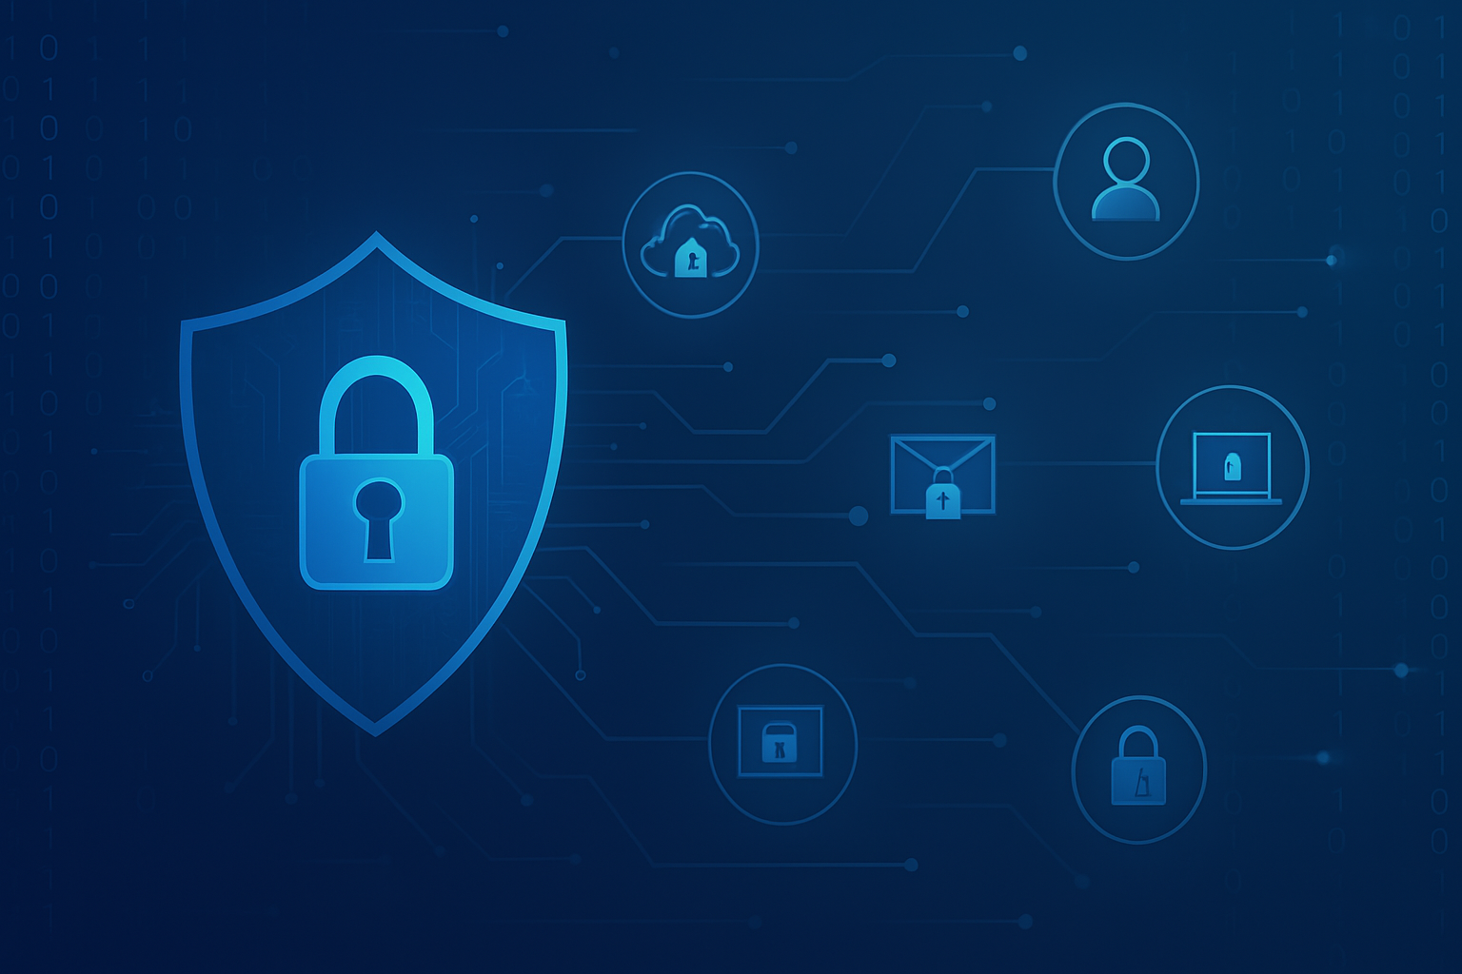
When It Really Happened

Slide 66
When It Really Happened – A Real Ransomware Attack
Our organisation used a third-party system for scheduling care visits.
On one occasion, during what was supposed to be a routine system update, the platform went offline and didn’t return even after 2 hours.
I suspected something was wrong and contacted the software provider directly.
They confirmed they were under a ransomware attack – attackers had encrypted all system data.
We were assured that there were no signs of data leakage, as no unusual data transfers were recorded.
However, the real problem was operational – no one could view any scheduled care appointments.
Our team and all carers were effectively left in the dark, with no access to the daily rota.

Slide 67
How We Recovered in 3 Hours :
Backup, Action, Teamwork
Thankfully, we were using a separate system for care plans and task management.
I quickly led an effort to reconstruct the schedule manually using the available care task data.
We created a custom spreadsheet-based rota, built to filter and map appointments in real time.
Rotas were emailed directly to each carer to keep visits on track.
This ad-hoc system was built and deployed in under 3 hours from the moment of system failure.
No care appointments were missed. Clients received their visits on time.
What saved us? A combination of:
A working backup system
Fast threat identification
And immediate action with clear roles

Slide 68
DSPT: From Recovery to Readiness
A few months after the incident, we attended a DSPT introductory session led by Baz (organised by Emcare).
The session helped us clearly assess our digital resilience:
What we did well under pressure
What gaps and risks still existed
I took personal responsibility for completing the DSPT submission.
During this process, I realised:
The practices that helped us recover—like backups, staff awareness, and fast communication—are exactly what the DSPT toolkit promotes.
But we were also missing documented policies, access control logs, and formal risk assessments.

Slide 69
DSPT: From Recovery to Readiness
Since then:
We’ve successfully submitted the DSPT for two consecutive years.
We are currently working on our third year submission.
The DSPT didn’t just tick a box—it gave us a framework for thinking, for acting early, and for strengthening our entire organisation.

Slide 70
Session 4:
Implementing Cybersecurity Measures

Slide 71
Session 5:
Incident Response and Reporting

Slide 72


Business Continuity Planning (BCP)
digitalsocialcare.co.uk
/bettersecuritybettercare

Slide 73

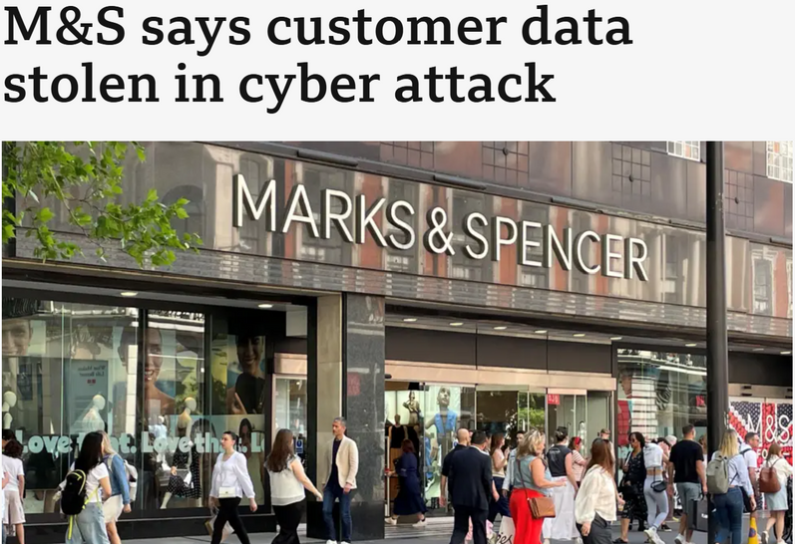
Better Security Better Care
With high profile incidents and cyber attacks, hitting the headlines on what feels like a daily basis sometimes, BCP have never been so important

Slide 74
Better Security Better Care
Business Continuity Plans
Support
Business Continuity Planning | Digital Care Hub
Creating and testing a business continuity plan
Business Continuity Plan Audit Tool | Digital Care Hub
Business Continuity Plan Deep Dive | Digital Care Hub
Business Continuity – The Care Provider Alliance

Slide 75
Better Security Better Care
Implementing Business Continuity Plans
Office unavailability i.e. flood or fire
Phone and broadband failure
Power cut
Cyber attack
Broken device
Supplier failure
What else?

Slide 76
Better Security Better Care
Testing Business Continuity Plans
Nationwide power cut
Can you access your building?
How long will your devices work?
Can you access your work documents?
Can you communicate?
Can you travel?
Do any of the people you support require power critical support?

Slide 77

Baz Kanabar
Damon Habbin
digitalsocialcare.co.uk
/bettersecuritybettercare

Slide 78
Session 6:
Empowering Care Teams Through Cyber Training

Slide 79
Cyber Security Training – What’s the point, and what are the options?
Fiona Florey
Engagement Manager

Slide 80
Why does Cyber Security staff training matter?
Value of information
  Lots of personal data – clients, staff, supply chain.
Staff can be your biggest vulnerability!
  It's recorded that between 80/95% of breaches are due to human "error" at some point. Whether opening a phishing email or not configuring their software correctly.
BUT, this is not normally through negligence or intention.
  Develop understanding, embed robust cyber security practices and an open and honest reporting mechanism it in our culture to enhance cyber resilience.
Cyber security isn’t a senior management issue alone! It’s everyone’s business. What level of knowledge do you need to meet the demands of your role and responsibilities – complete a training needs analysis!

Slide 81
Why does Cyber Security staff training matter?
DSPT compliance
  Question 3.2.1: Have at least 95% of staff, directors, trustees, and volunteers completed training on data security and protection, and cyber security, in the last twelve months.
  Question 3.1.1: Has a training needs analysis covering data security and protection, and cyber security, been completed in the last twelve months?
  CQC compliance and evidence
  W2.8: “How does the service satisfy itself that it has robust arrangements (including appropriate internal and external validation) to ensure the security, availability, sharing, and integrity of confidential data, and records and data management systems, in line with data security standards?”
  C3.3: “How are people assured that information about them is treated confidentially and securely?”

Slide 82
How can we support staff learning
Formal Training
Digital Care Hub FREE E-learning, developed specifically for the care sector
Cyber Game
Digital Care Hub FREE Cyber Game, developed specifically for the care sector
Informal Training
Keep it on your agenda – have regular digital/cyber discussion points in team meetings
Ask subject matter experts to attend your workplace and trouble shoot or present
Cyber Testing
Webinars & Communities of Practice
Create digital champions and use them to upskill your workforce
Test your cyber responses to help bring cyber to life – send test emails to check that your staff have their wits about them.
Turn off your systems to simulate a connection outage and see how the team would manage.
Review the learning, share this amongst your staff, and identify improvements
Utilise free webinars and communities of practice to upskill and share knowledge and experiences.
Digital Care Hub
Skills for Care
Your local Care Association
Check out:
More information to follow!
More information to follow!
National Care Forum
Homecare Association
Discussion Tool & Competency Framework

Slide 83
Links
Digital Care Hub: https://www.digitalcarehub.co.uk/
Discussion Tool & Competency Framework: https://www.digitalcarehub.co.uk/digital-skills-and-training/data-protection-discussion-tool-and-competency-assessment/
Training Needs Analysis:
Skills for Care : https://www.skillsforcare.org.uk/Home.aspx
Your local Care Association : https://www.digitalcarehub.co.uk/data-protection-and-cyber-security/better-security-better-care/local-support-partners/
National Care Forum : https://www.nationalcareforum.org.uk/
Homecare Association : https://www.homecareassociation.org.uk/

Slide 84
FREE Data Security & Protection E-Learning

Slide 85
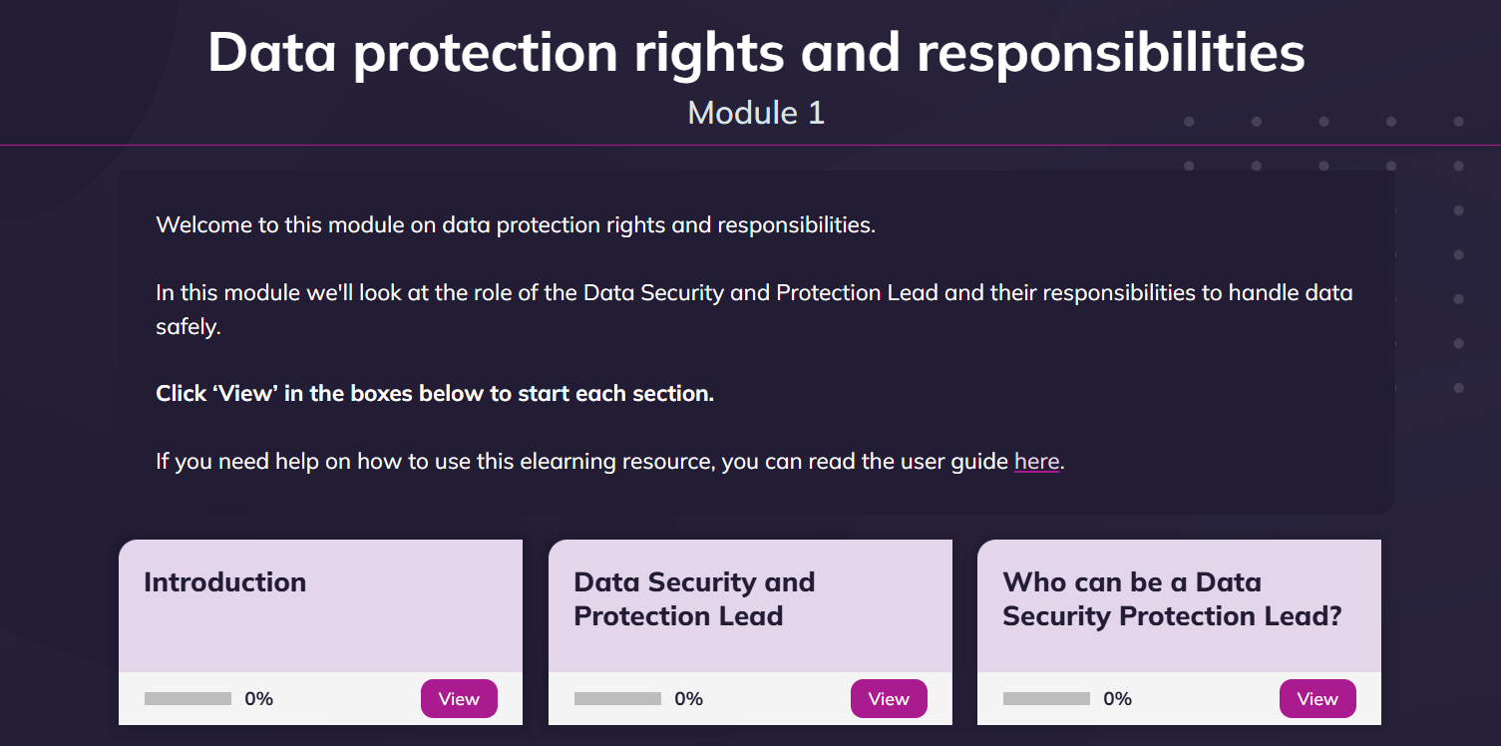
FREE Data Security & Protection
E-Learning
All adult social care organisations should meet the Data Security and Protection Toolkit standards each year
This includes providing annual training for everyone with access to personal data
But no easy to access, free and sector-appropriate national training available
Better Security, Better Care has developed 2 courses in response to a gap in the market
Data Security & Protection – Staff Data Security & Protection – Leads
FREE
Relevant
Good Quality
Certificated
eLearning Courses - Digital Care Hub
Notes:
(a) Consider whether the Exploitation Plan has been updated to reflect: (i) any significant developments in the Project (in terms of milestones or objectives); (ii) any changes in the market; and (iii) any changes in terms of any intellectual property developments of the Project Participants or their competitors.
(b) Ask for confirmation (and evidence where appropriate) that the necessary applications and registrations in respect of intellectual property rights are in place.
(c) Raise any particular concerns about exploitation and commercialisation (either existing or future).
(d) The MO will provide an overall score for 'Exploitation' in the Monitoring Report taking account of the above factors in accordance with the relevant matrix specified by Innovate UK.

Slide 86
About the E-Learning Courses
• Relevant to all services: includes examples from home care, residential care, supported living and community services
• Staff version is relevant to all roles: frontline workers, admin, receptionists, volunteers etc. Leads version is relevant to Data Protection Leads, Managers, Digital Champions/First Aiders etc.
• Short: 10 - 20 mins per module
• Flexible: can be completed over time
• Interactive: quizzes, graphics, videos and short tips
• Free and open access – SCORM compliant version available on request
• Online assessment: score 80% or above and get a certificate
• Meets Data Security and Protection Toolkit (DSPT) training requirements: 95% staff to be trained within last 12 months

Slide 87
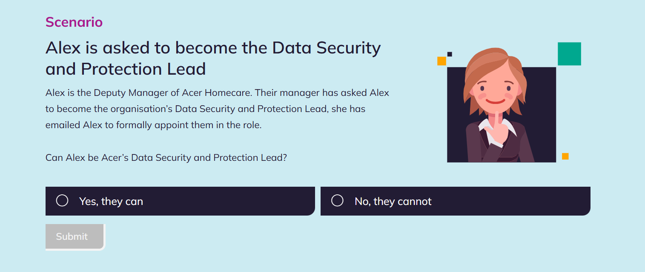
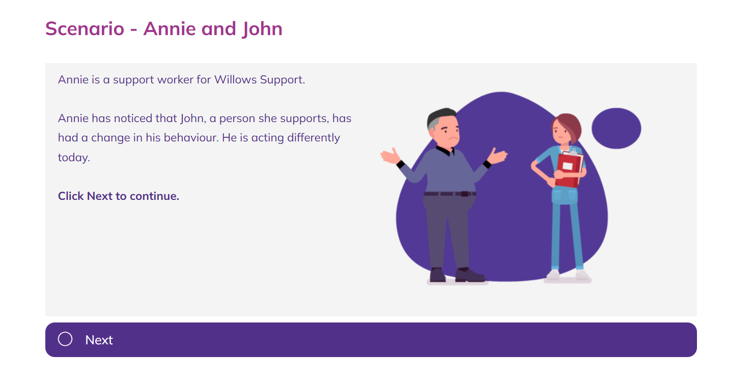
Based on relatable characters

Slide 88
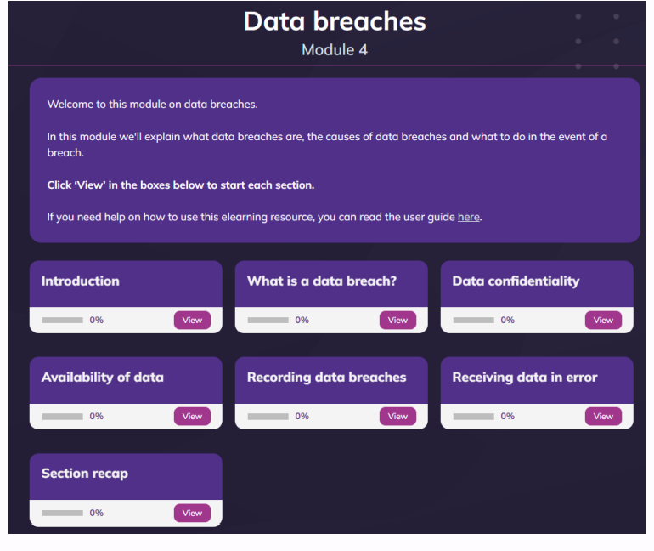
4 Modules per course
Multiple sections to work through
Section recap to reinforce learning at the end

Slide 89
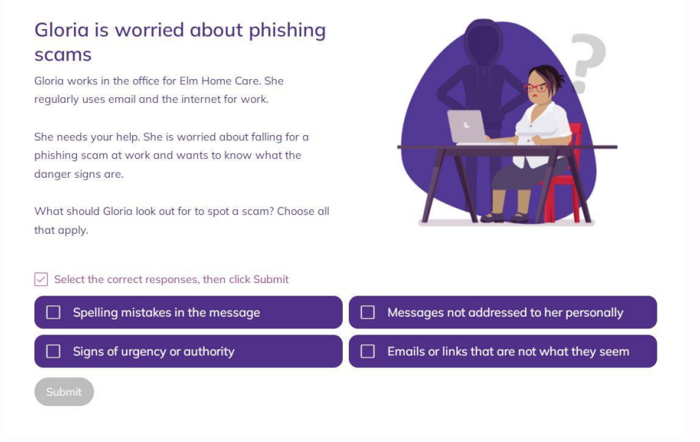
Examples of Content
Relevant scenarios
Short content
Multi choice questions to support learning (not part of the assessment)

Slide 90
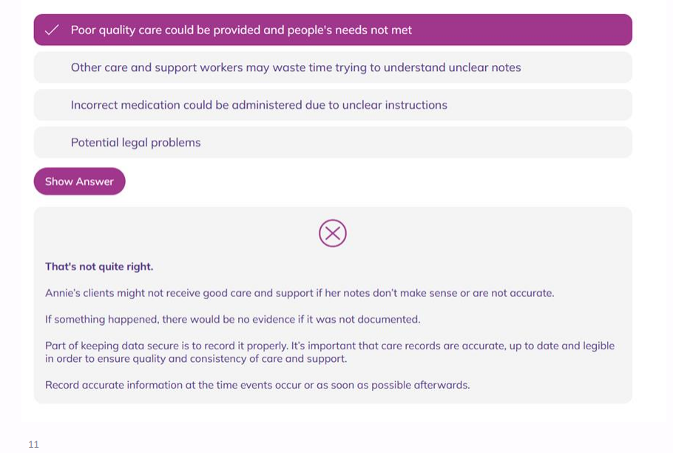
Examples of Content - comments
Read comments based on your response

Slide 91
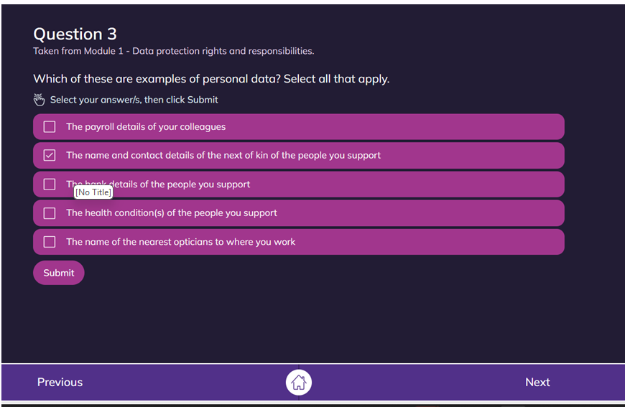
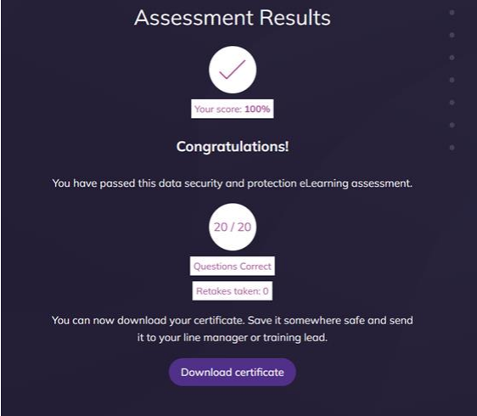
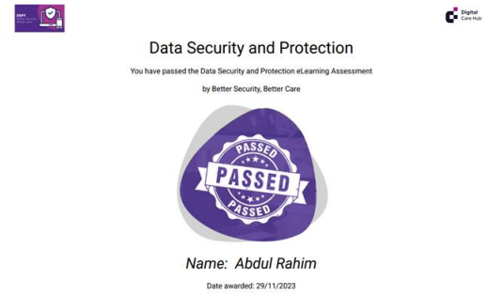
Assessment & Certification
- Get 80% or more correct to pass
- Certificate awarded and can be collated to prove staff training
Questions based on all 4 modules
Questions are drawn from a database of questions, so they are not the same each time you complete the assessment

Slide 92
Tips for Managers & Trainers
• Read the managers guides before you share the elearning courses with staff.
• Encourage all your staff to complete the relevant elearning course. That includes senior managers, volunteers, and admin staff as well as frontline care workers.
• Add the staff elearning course to your induction training. It will help to ensure that all staff have a shared understanding of data protection issues.
• Schedule in an annual refresher course. You need to train staff at least once a year.
• If you have an LMS, add this course to it.
• Add a link to the resource in your staff bulletin, noticeboard or shared documents system.
• Record successful completion of this course against staff members’ training records.
• Ensure training records are up to date by the time you submit your annual DSPT.

Slide 93
Links
ELearning for Staff
E Learning – Staff: https://www.digitalcarehub.co.uk/digital-skills-and-training/elearning/staff/
Managers Guide: https://www.digitalcarehub.co.uk/digital-skills-and-training/elearning/staff/guide-for-managers-and-trainers/
Staff Guide : https://www.digitalcarehub.co.uk/digital-skills-and-training/elearning/staff/user-guide/
Elearning for Leads
E Learning – Leads: https://www.digitalcarehub.co.uk/digital-skills-and-training/elearning/leads/
Staff Guide: https://www.digitalcarehub.co.uk/digital-skills-and-training/elearning/leads/user-guide/
Request SCORM Files
Request SCORM Files: help@digitalcarehub.co.uk

Slide 94
FREE Cyber Game

Slide 95
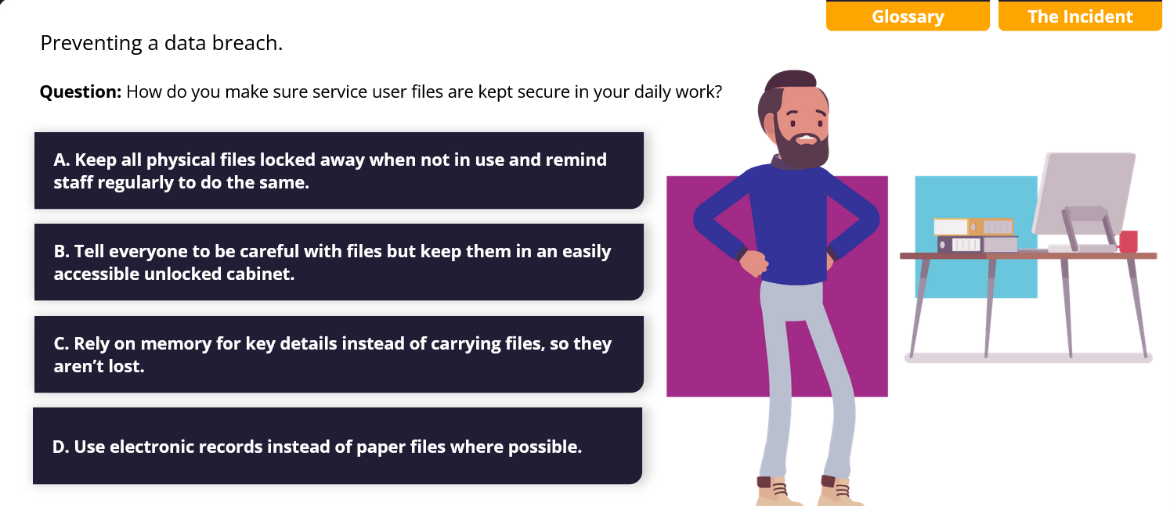
Cyber Game
A "choose your own adventure" gamified cybersecurity tool
Walking you through the controls you should have in place to prevent a cyber-attack and the consequences of actions you may take to respond and recover during and after an incident in a fun, interactive environment.

Slide 96
What is the Cyber Game useful for?
Fun, quick and entertaining way to learn about cyber security.
Free online resource that can be combined with more in-depth cyber training or DCH E-learning modules.
Learning Outcomes
Understand practical importance of cyber security in social care.
Learn how to respond effectively to different types of cyber incidents.
Improve your decision-making skills.
Enhance your knowledge of data protection and compliance.
Access a suite of links and resources for adult social care staff.

Slide 97
Lets Play!
play - Digital Care Hub

Slide 98
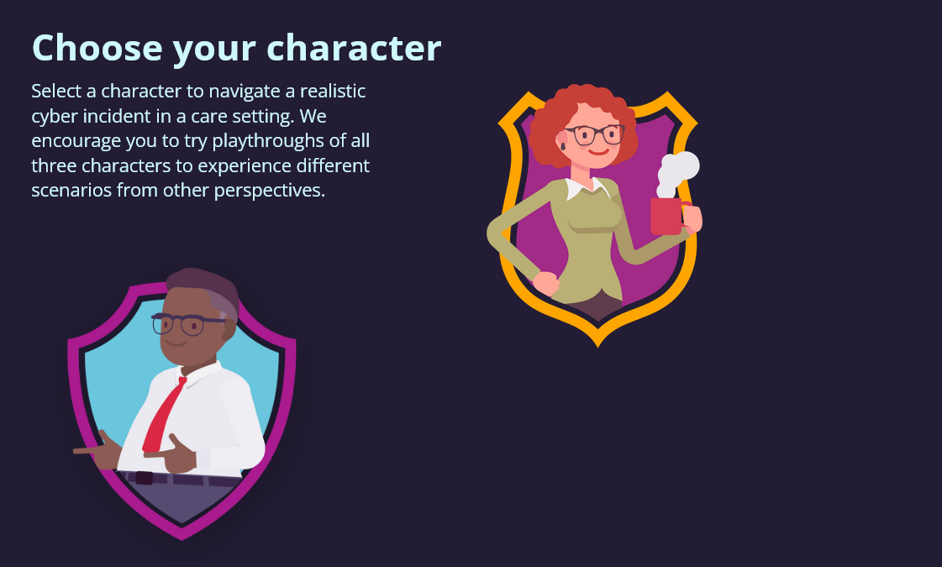

Character selection
You will be prompted to select a character that represents a specific role within the care sector:
A Registered Manager
DPO/Policy Lead
Carer
We strongly encourage you to play through multiple characters to understand everyone’s different perspective. Each character will face unique cyber security challenges relevant to their role.

Slide 99
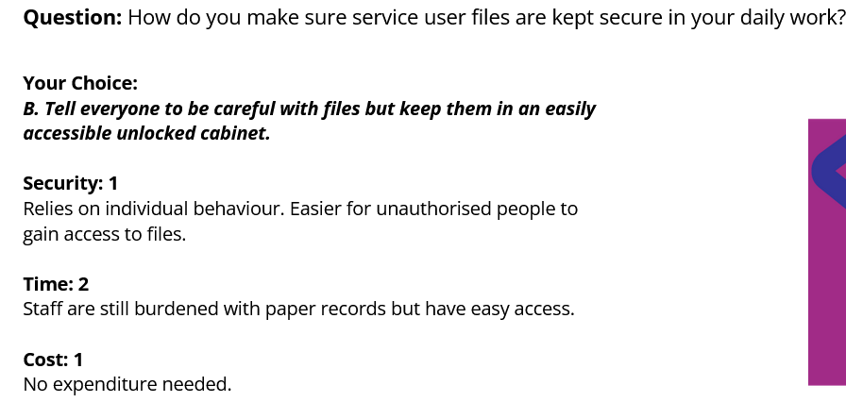
Immediate feedback
Each time you make a choice, you will receive some immediate feedback about how your option scores (1-3) in each category and what some of the real-life implications are.

Slide 100
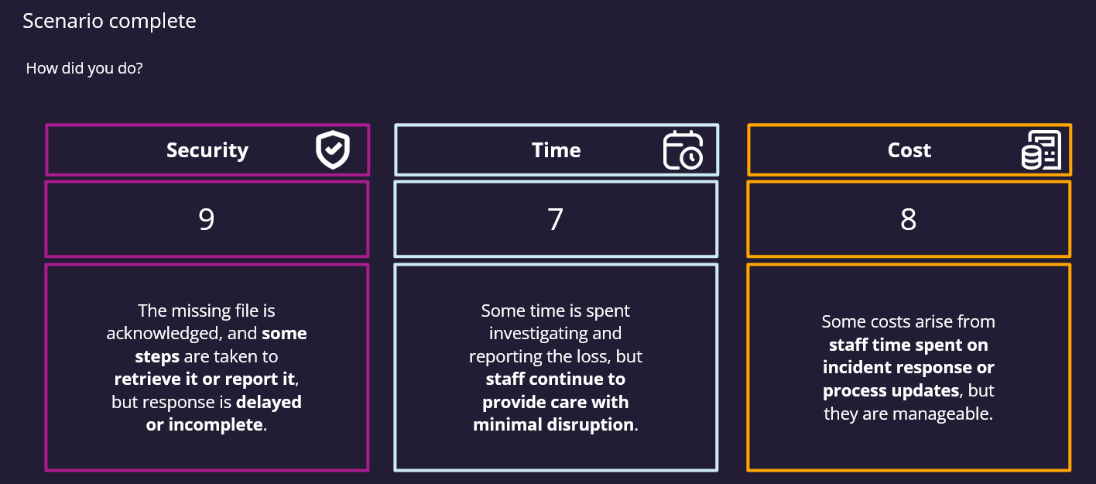
Scoring
When you finish, you will receive total scores for all three categories: Security, Time, and Cost. There is no perfect score, it’s about balancing security with time and cost.

Slide 101
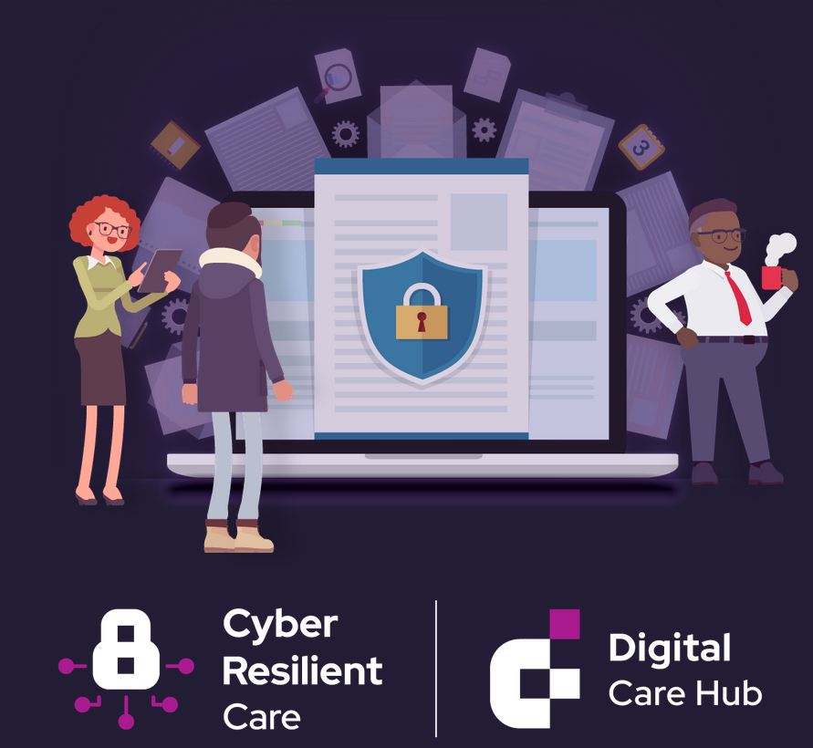
How should we use this?
This cyber game is completely free to use and access for the entire adult social care sector.
You can use this fun game in your training, induction, supervisions, team meetings & ‘back to basics’ exercises.
Find out who best navigates the cyber scenarios from each perspective! Consider having that person involved when reviewing your business continuity plan.

Slide 102

Links
Play the game: https://www.digitalcarehub.co.uk/digital-skills-and-training/games/cyber-game/play/
Players Guide: https://www.digitalcarehub.co.uk/digital-skills-and-training/cyber-game/players-guide/

Slide 103
Final Thoughts
Make sure your training is fit for purpose
Keep cyber on your agenda – it’s more than just annual training, it’s a culture
Be creative with how you upskill your staff
  Try the cyber game
  Develop digital champions/first aiders
  Invite subject specialists to share knowledge
  Join webinars and networks/communities of practice
  Bring cyber to life!
  Learn from mistakes, issues and drills

Slide 104
THANK YOU – Any questions?
Fiona Florey – fiona@digitalcarehub.co.uk
Eleanor Ryles – eleanor@digitalcarehub.co.uk

Slide 105
Q&A Panel Session

